Slide 1

Distributed Locking Explained
A Practical Guide for System Architects and Backend Engineers

Slide 2




Once Upon a Time... The Ancient Ways
We have a simple traditional voting system:
One Room
One Voter
One Lock (the door!)
A cozy, private space.
Peaceful, undisturbed.
Perfect correctness, terrible speed.

Slide 3

Version 1: The Local App
Our first foray into digital democracy:
A single mobile app to pass around.
Voters queued for hours...

Slide 4
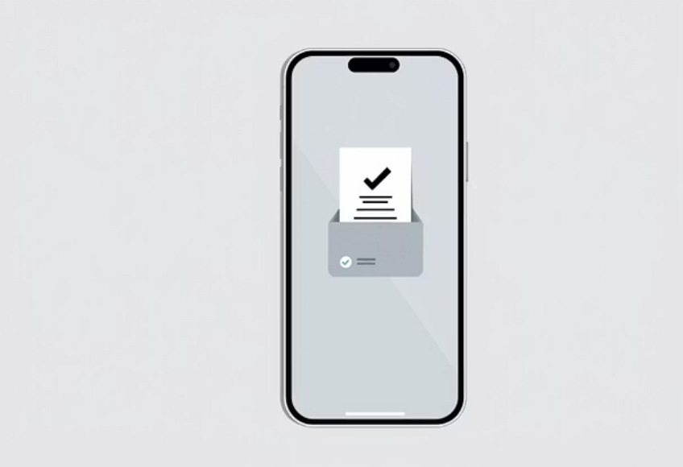
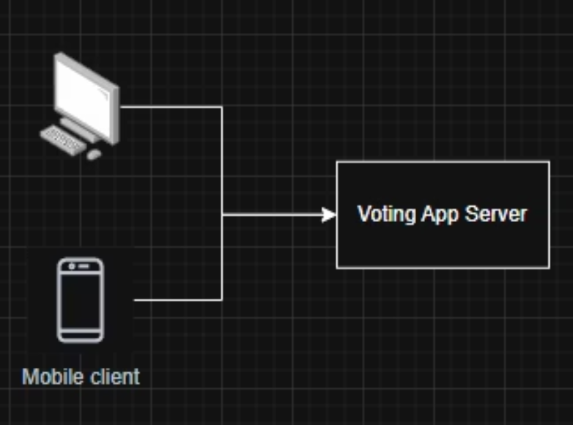
Version 2: The Shiny Web App + One Big Server
Everyone votes from their phone! So modern, so convenient! ✨
But then... the race condition reared its ugly head.
Read vote count (5)
Read vote count (5)
Write new count (6)
Write new count (6)
One vote vanished! 👻

Slide 5
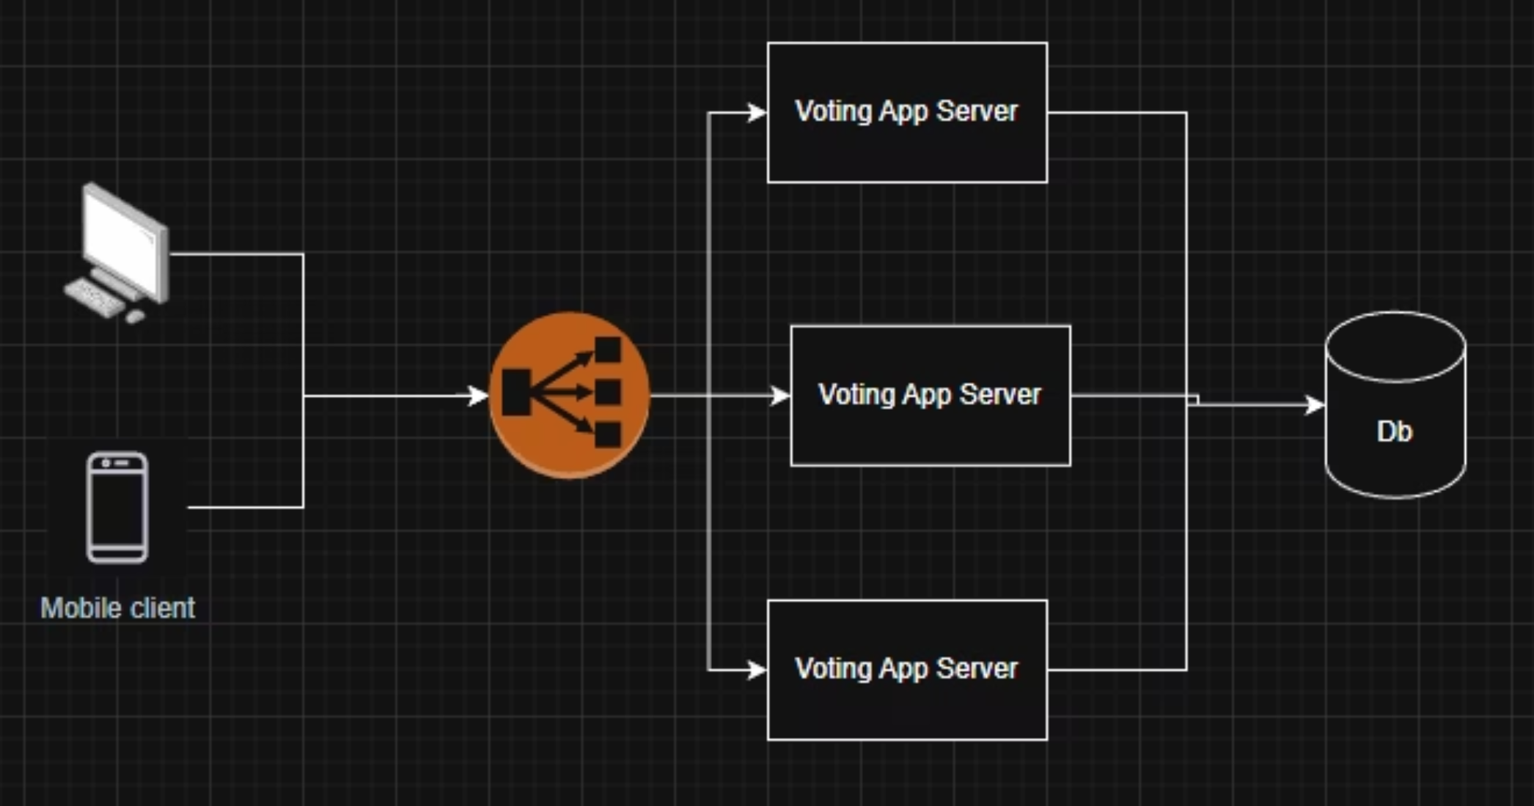
Version 3: Horizontal Scaling + Database
More servers, more power! We scaled up to:
But a new nightmare emerged: two different servers updating the same row at once!

Slide 6
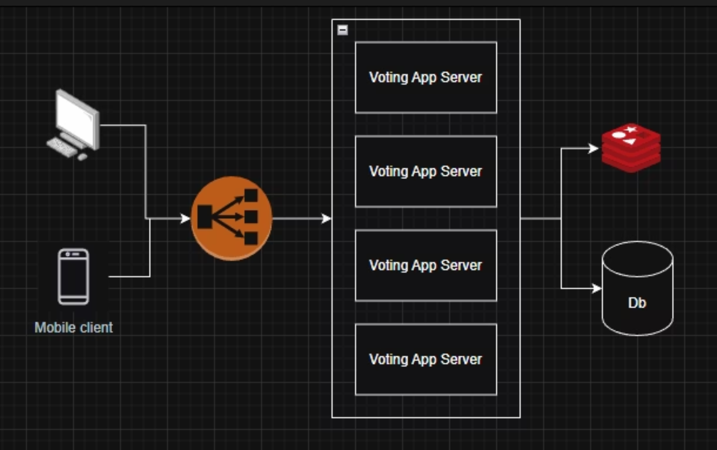
Redis Distributed Lock
When vote, create a lock key => Remove when done/fail

Slide 7

Problem 1: Server down
Server down => Lock forever
=> Solution: set TTL … but how long?

Slide 8
Problem 2: Process pause
GC run => Process pause
Delete another client's lock
=> Solution: Set random UUID as value to identify.

Slide 9
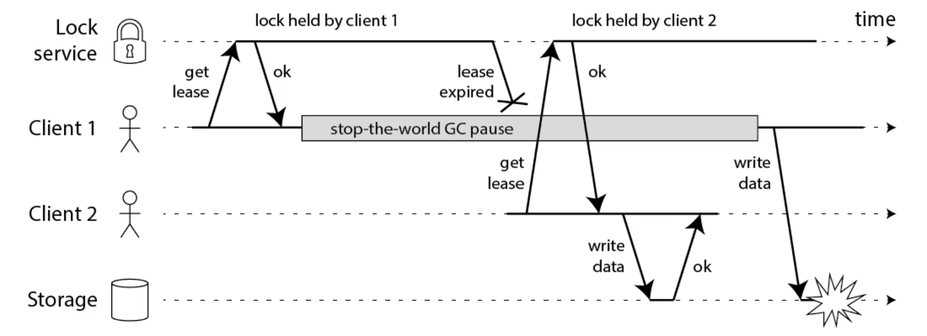
Problem 2: Process pause
GC run => Process pause
=> Solution:
Fencing token

Slide 10
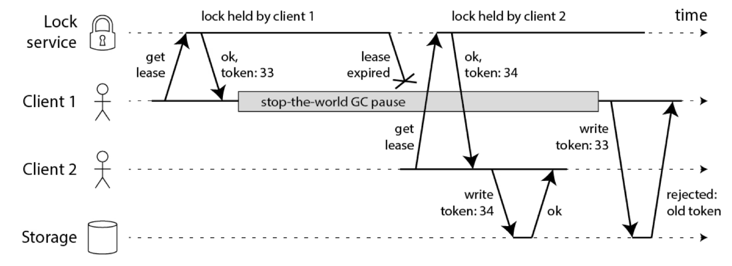
Fencing token

Slide 11
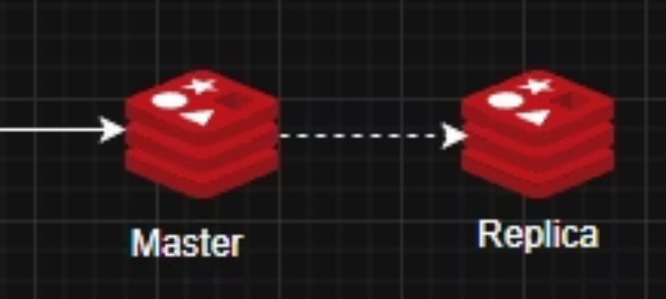
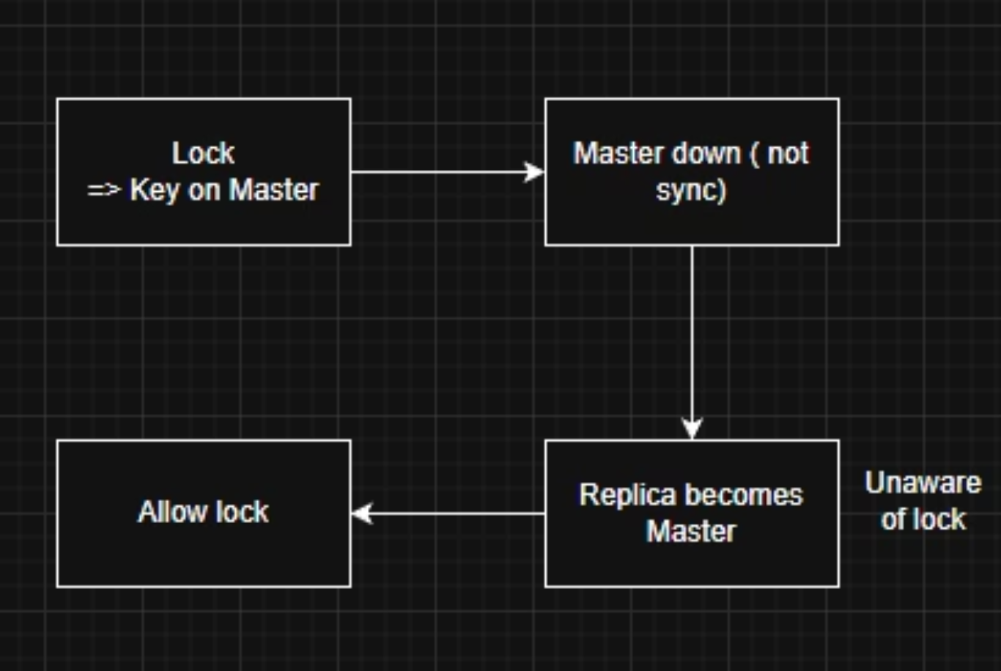
Problem 3: Redis fail
Async Replication ?
Two instance could obtain the same lock:

Slide 12
Database Pessimistic Locking
Our brilliant solution: SELECT ... FOR UPDATE
Correctness? ✅ Absolutely!
But then, the performance hit and deadlock dance began.

Slide 13
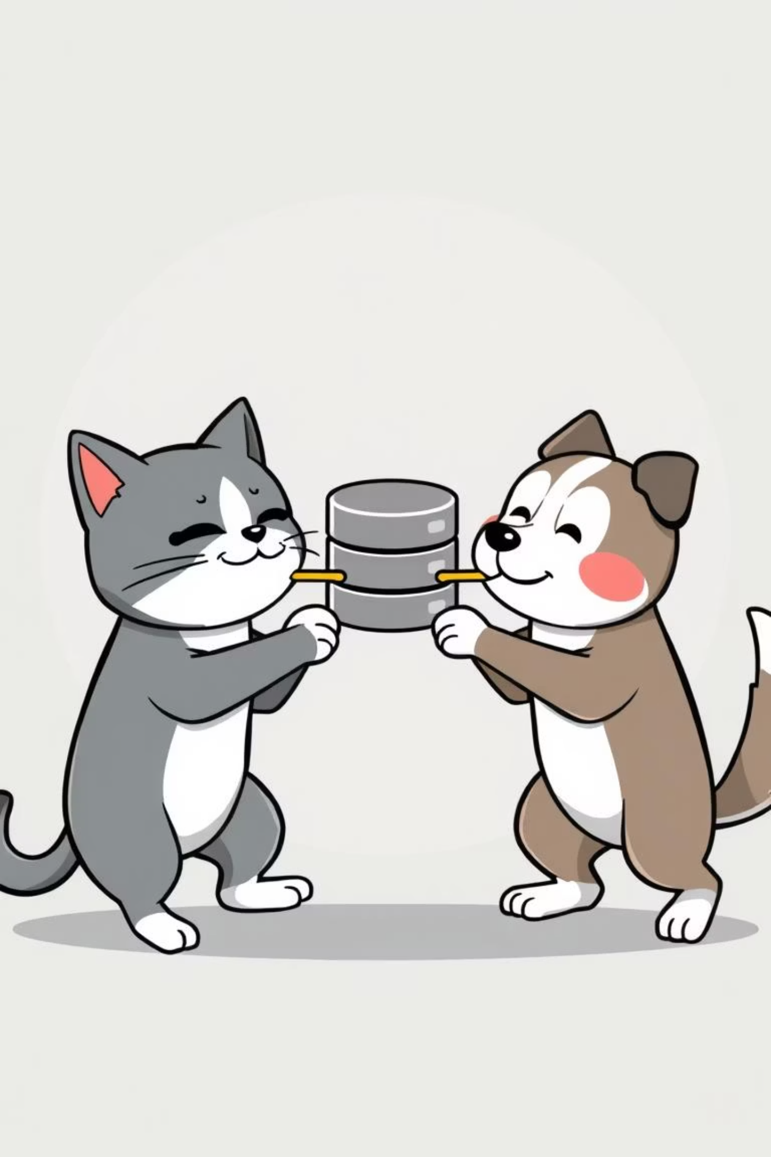
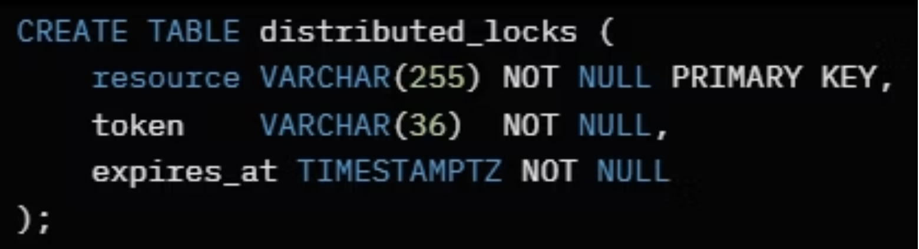
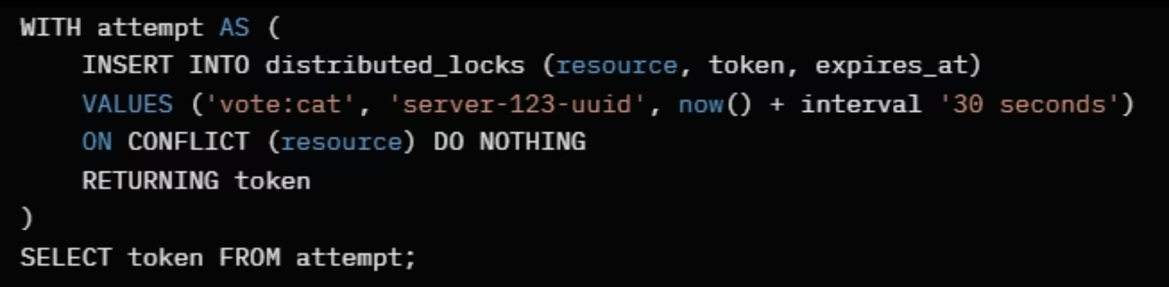
Database Lock Table
A dedicated lock table + INSERT ON CONFLICT. Works perfectly when you only have 2 parties contending for 2 hot rows forever!

Slide 14

Apache ZooKeeper 🐘
Our mighty elephant, ZooKeeper (or its cousin etcd), to the rescue!
It uses ephemeral sequential nodes:
Each client creates a unique node.
Smallest sequence ID gets the lock.
Node is deleted automatically if client crashes.
Crash = Auto-Release! No more lingering locks!

Slide 15
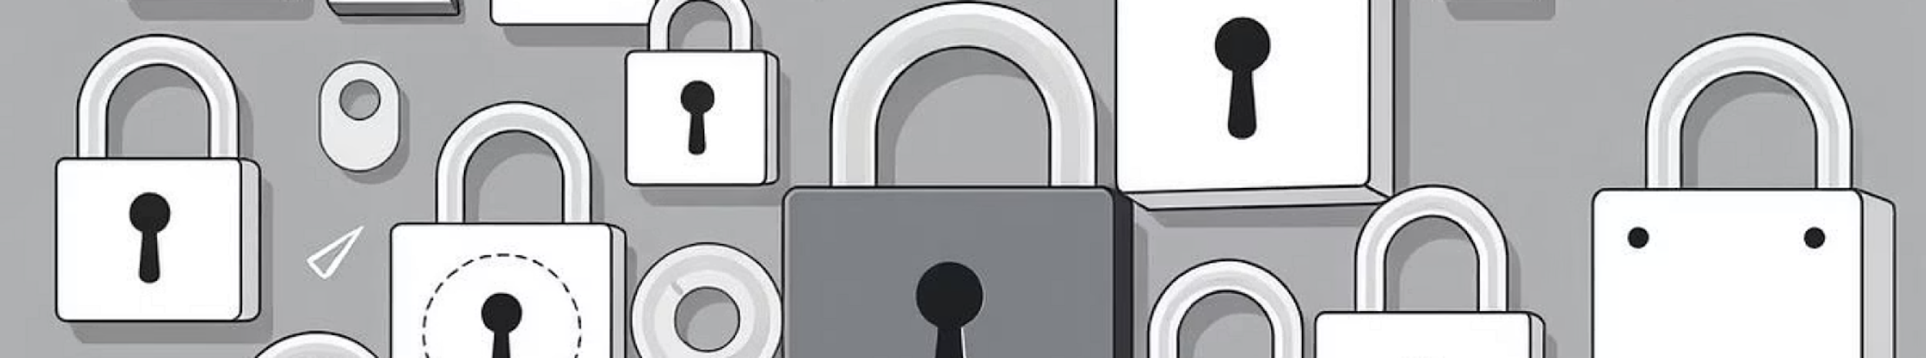
Choose Your Lock Wisely!
Just like choosing the right party outfit, picking the right lock is crucial!
Single Thread
DB Locks
Works great! ... but doesn't scale for a party this big.
Correct, but too slow for peak vote season.
Redis Locks
ZooKeeper/etcd
Fast! ... but can lose correctness.
Bullet-proof (but heavier). The ultimate party bouncer.

Slide 16




The Right Lock for Your Election's Importance 🗳️
How important is your distributed election? Choose a lock that matches the gravity of your feline or canine conflict.
ZooKeeper/etcd
1
Mission Critical
DB Locks
2
Important
Redis Locks
3
Less Critical
Single Thread
4
Trivial

Slide 17

Thank You! Questions?
Stay calm and collected, just like a ZooKeeper user!

